Slide 1

PI and Thermal Simulation Study for BD95841MUV Board
December 26th, 2013
Hosted by: Xuan Dang

Slide 2
Agenda
Introduction
DC Drop Analysis
Current Density Analysis
Thermal Analysis
Conclusion

Slide 3
Introduction
This work considers power simulation and thermal simulation on BD95841MUV boards.
Based on board file BD95841MUVEVK-101_EVAL_BRD_REV01_20131226_1800.brd
Hyperlynx v8.2.1 and Hyperlynx Thermal v9.1 (MentorGraphic) software is used for simulation
PI simulation considers:
DC Drop analysis
Determine what the max drop for power rail
Current Density analysis
Determine the hot spot of current density on PCB
Thermal simulation considers:
PCB temperature profile including consideration for conductive, radiative, and convective heat transfer

Slide 4
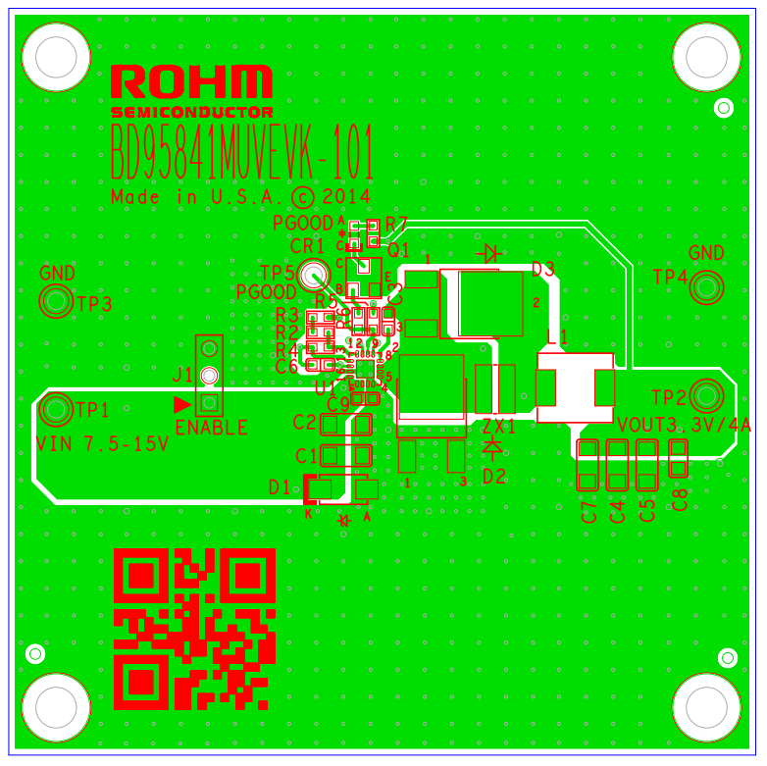
BD95841MUV Board
Based on the board file : BD95841MUVEVK-101_EVAL_BRD_REV01_20131226_1800.brd
Vin 5V/div (DC)

Slide 5
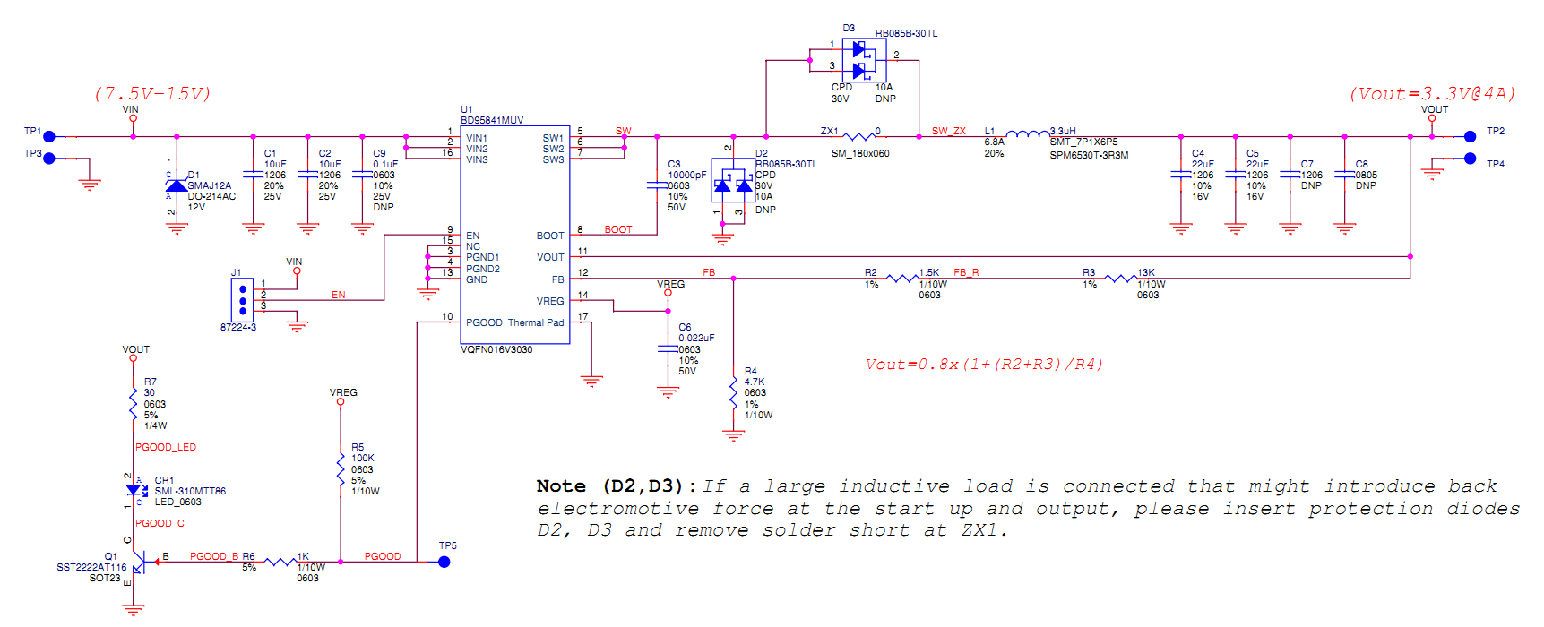
BD95841MUV Schematic
Based on the schematic file : BD95841MUV_EVAL_SCH_REV01_20131226_1800.pdf

Slide 6
BD95841MUV Board power consumption
Device/rail | Source/VRM refdes | Source PCB netname | Sink/load PCB refdes | Load PCB net name | Nominal Voltage(V) | Voltage tolerance (%) | Max current (A) | Power input (W) | Power consumption (W) | Note
Power input via TP1/TP3 connectors (VIN 7.5-15V) | TP1 | VIN | U1 | VIN | 7.50 |  | 2.5 | 18.75 |  | Max input current = (Pout + PONH + PONL + PL)/VIN = 2.05A with Vin =7.5V (worst condition). So we choose max input current =2.5A to simulate power/thermal
Power dissipation on BD95841MUV internal FETs | TP1 | VIN | U1 | VIN |  |  | 4.00 |  | 1.7216 | RONH=0.13 Ohm; RONL=0.09 Ohm
Power dissipation on inductor L1 | ZX1 | SW | L1 | SW_ZX |  |  | 4.00 |  | 0.4752 | RL = 0.0297 Ohm
Power consumption at load via connector TP2/TP4 (VOUT 3.3V) | L1 | VOUT | TP2 | VOUT | 3.3 | 2 | 4.00 |  | 13.2
 |  |  |  |  |  |  | Total | 18.75 | 15.3968

Slide 7
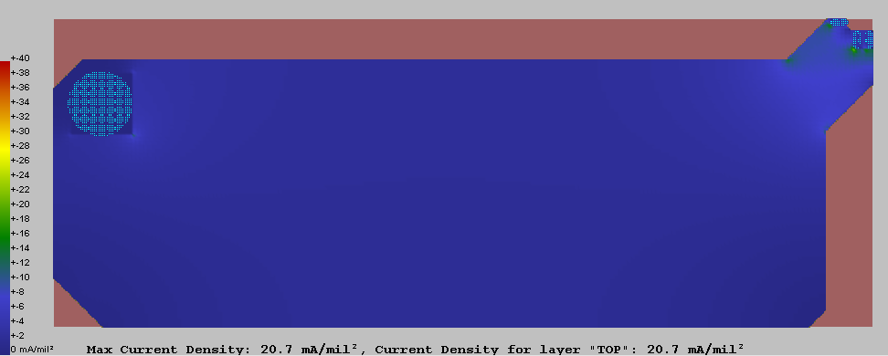
Current Density analysis for VIN 7.5V@2.5A
Source TP1
Load U1
Max Current Density 20.7 mA/mil² < 40mA/mil² (This rule limit 10 Celsius degree of temperature rise above ambient) → Copper planes for VIN is OK

Slide 8
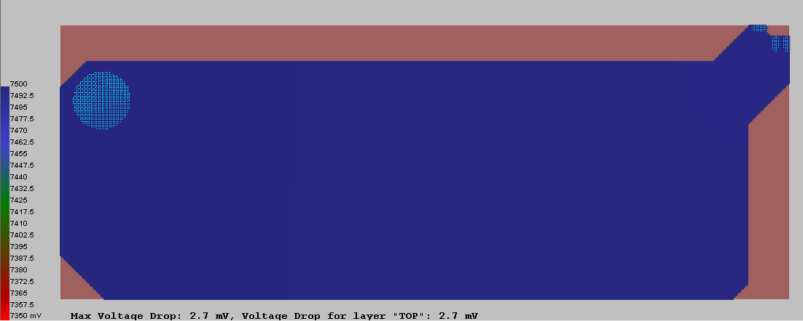
DC Drop analysis for VIN 7.5V@2.5A
Load U1
Source TP1
Max DC Drop 2.7mV < 150mV (2% tolerance of 7.5V) → Copper planes for VIN is OK

Slide 9
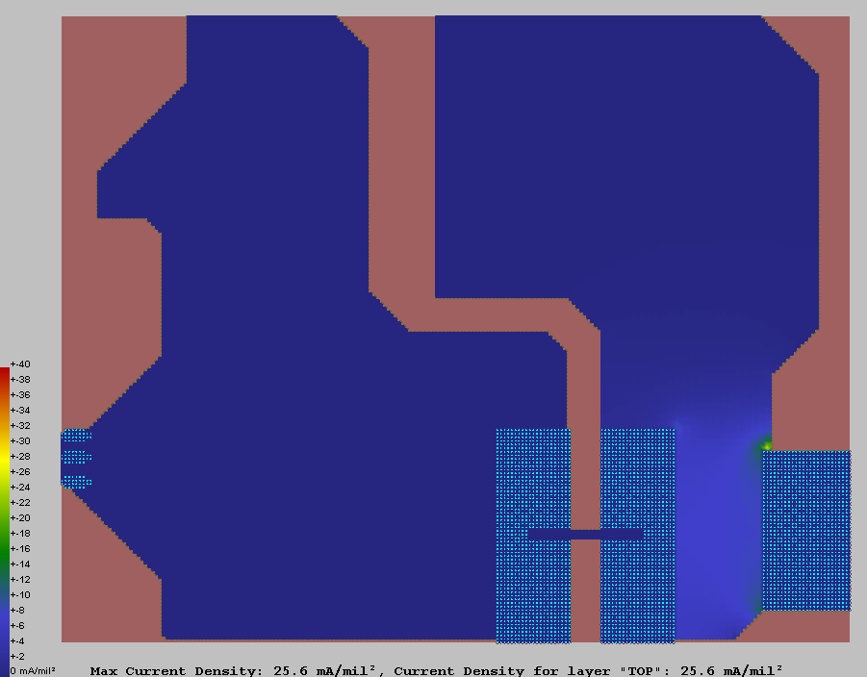
Current Density analysis for SW@4A
Source U1
Solder-shorted ZX1
Load L1
Max Current Density 25.6mA/mil²<40mA/mil² (This rule limit 10 Celsius degree of temperature rise above ambient) → Copper plane for SW is OK

Slide 10
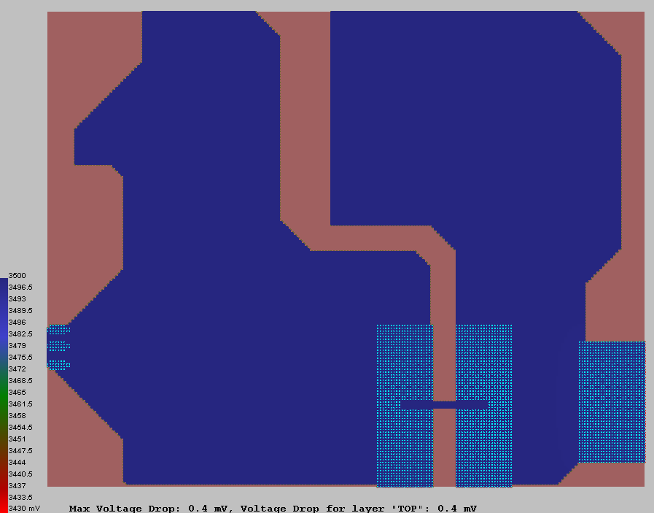
DC Drop analysis for SW@4A
Source U1
Solder-shorted ZX1
Load L1
Max DC Drop 0.4 mV < 70mV (2% tolerance of assumption voltage 3.5V) → Copper planes for SW is OK

Slide 11
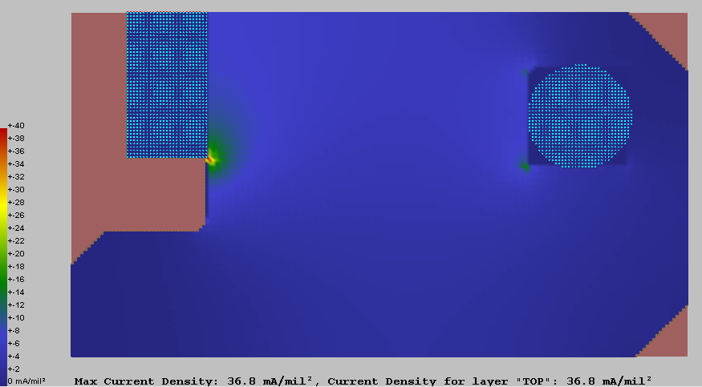
Current Density analysis for VOUT 3.3V@4A
Load TP2
Source L1
Max Current Density 36.8 mA/mil² < 40mA/mil² (This rule limit 10 Celsius degree of temperature rise above ambient) → Copper planes for VOUT is OK

Slide 12
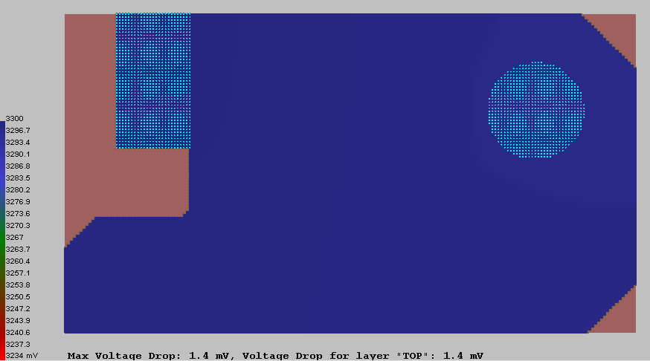
DC Drop analysis for VOUT 3.3V@4A
Load TP2
Source L1
Max DC Drop 1.4 mV < 66mV (2% tolerance of 3.3V) → Copper planes for VOUT is OK

Slide 13
Thermal Analysis
Environment conditions
Air Temperature : 25 ⁰C , 35 ⁰C and 45 ⁰C
Air Pressure: 1 atm
Gravity: 1
Humidity ratio: 0.5%
No incoming air flow (Natural convection)
Emissivity of board: 1
Board location : single board
System: closed
VOUT 20mV/div (AC)
SW 5V/div

Slide 14
Thermal Analysis (Con’t)
Component properties
 | BD96841MUV | SPM6530T-3R3M | RB085B-30TL (Diode D3) | SML-310MTT86 | SST2222AT116
Number of pins | 17 | 2 | 3 | 2 | 3
Pin length | 0.024” | 0.134” | 0.063” | 0.032” | 0.05”
Pin width | 0.010” | 0.073” | 0.019” | 0.032” | 0.04”
Pin thickness | 0.0086614” | 0.006” | 0.02” | 0.01” | 0.005”
Pin thermal conductivity | 223.031Btu/hrftF | 223.031Btu/hrftF | 223.031Btu/hrftF | 223.031Btu/hrftF | 223.031Btu/hrftF
Max. power dissipation | 1.7216 W (at Vin=7.5V) 1.616 W (at Vin=12V) | 0.4752 W | 1.92W | 0.044W | 0.012 W
VOUT 20mV/div (AC)
SW 5V/div

Slide 15
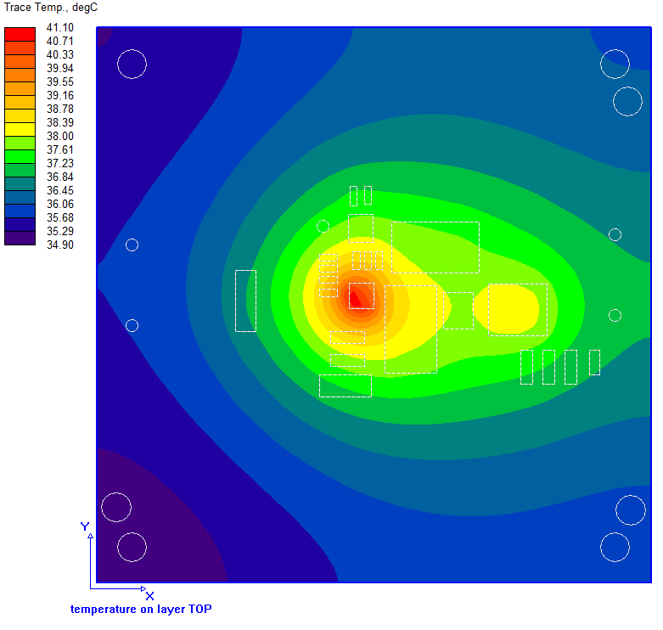
Thermal Analysis (Con’t)
Air temperature 25⁰C, power dissipation of BD95841MUV is 1.7216 W (at VIN=7.5V), exclude power dissipation of DNP diode D3 RB085B-30TL
U1: BD95841MUV
Max. power dissipation: 1.7216 W @VIN=7.5V
Component temperature = 57.9 ⁰C
L1: SPM6530T-3R3M
Max. power dissipation: 0.4752 W
Component temperature = 38.6 ⁰C
D3
D3:RB085B-30TL
Component temperature = 37.8 ⁰C
U1
L1
The highest temperature on board is about 41.1 ⁰C
The highest temperature on component is on BD95841MUV ( about 57.9 ⁰C)

Slide 16
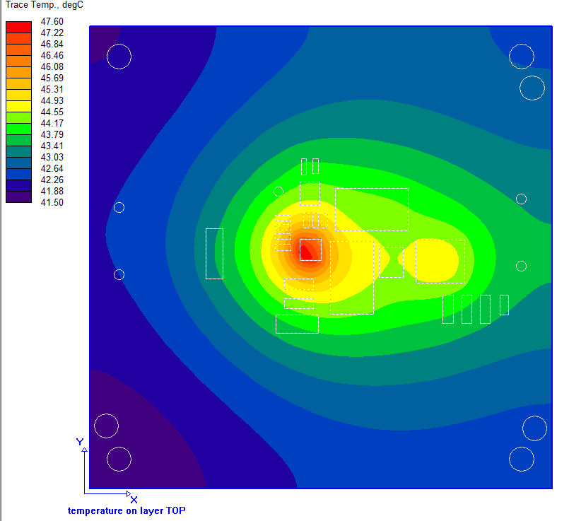
Thermal Analysis (Con’t)
Air temperature 35⁰C, power dissipation of BD95841MUV is 1.7216 W (at VIN=7.5V), exclude power dissipation of DNP diode D3 RB085B-30TL
U1: BD95841MUV
Max. power dissipation: 1.7216 W @VIN=7.5V
Component temperature = 64.5 ⁰C
L1: SPM6530T-3R3M
Max. power dissipation: 0.4752 W
Component temperature = 45.2 ⁰C
D3
D3:RB085B-30TL
Component temperature = 44.3 ⁰C
U1
L1
The highest temperature on board is about 47.6 ⁰C
The highest temperature on component is on BD95841MUV ( about 64.5 ⁰C)

Slide 17
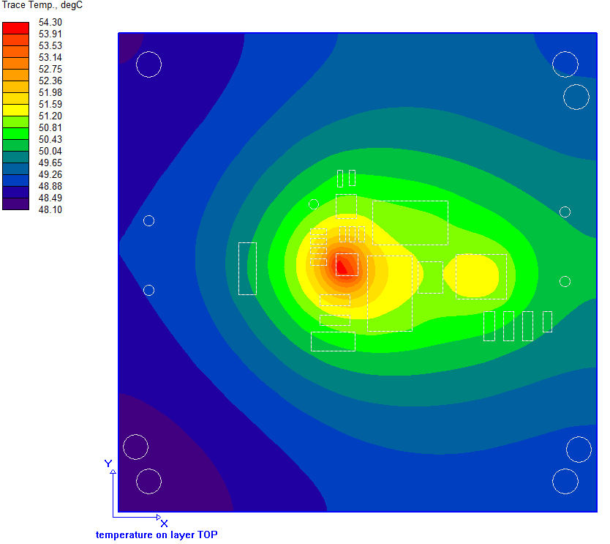
Thermal Analysis (Con’t)
Air temperature 45⁰C, power dissipation of BD95841MUV is 1.7216 W (at VIN=7.5V), exclude power dissipation of DNP diode D3 RB085B-30TL
U1: BD95841MUV
Max. power dissipation: 1.7216 W @VIN=7.5V
Component temperature = 71.1 ⁰C
L1: SPM6530T-3R3M
Max. power dissipation: 0.4752 W
Component temperature = 51.8 ⁰C
D3
D3:RB085B-30TL
Component temperature = 51 ⁰C
U1
L1
The highest temperature on board is about 54.3 ⁰C
The highest temperature on component is on BD95841MUV ( about 71.1 ⁰C)

Slide 18
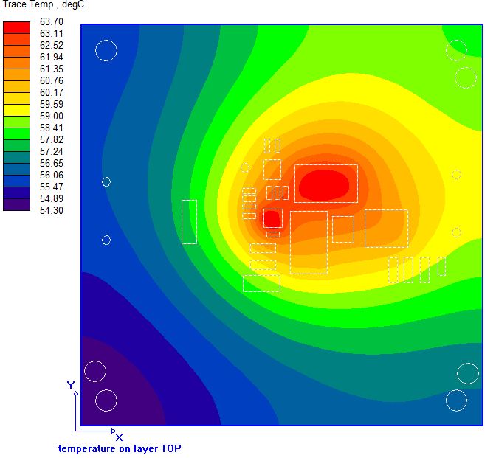
Thermal Analysis (Con’t)
Air temperature 25⁰C, power dissipation of BD95841MUV is 1.7216 W (at VIN=7.5V), include power dissipation of DNP diode D3 RB085B-30TL
U1: BD95841MUV
Max. power dissipation: 1.7216 W @VIN=7.5V
Component temperature = 80.6 ⁰C
L1: SPM6530T-3R3M
Max. power dissipation: 0.4752 W
Component temperature = 61.6 ⁰C
D3
D3:RB085B-30TL
Max. power dissipation: 1.92 W
Component temperature = 64.5 ⁰C
U1
L1
The highest temperature on board is about 63.7 ⁰C
The highest temperature on component is on BD95841MUV ( about 80.6 ⁰C)

Slide 19
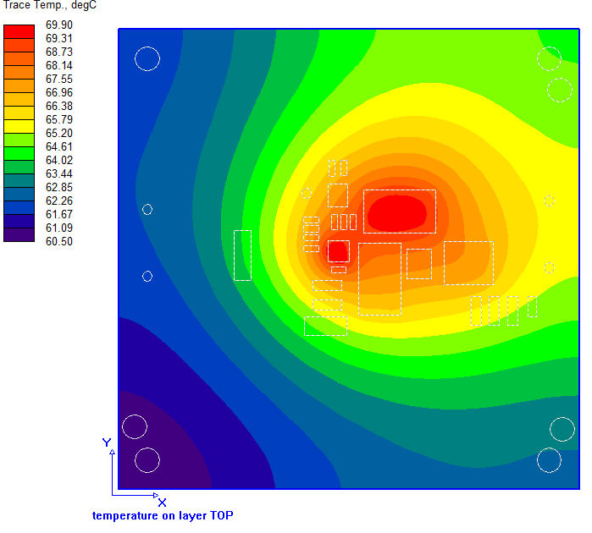
Thermal Analysis (Con’t)
Air temperature 35⁰C, power dissipation of BD95841MUV is 1.7216 W (at VIN=7.5V), include power dissipation of DNP diode D3 RB085B-30TL
U1: BD95841MUV
Max. power dissipation: 1.7216 W @VIN=7.5V
Component temperature = 86.9 ⁰C
L1: SPM6530T-3R3M
Max. power dissipation: 0.4752 W
Component temperature = 67.8 ⁰C
D3
D3:RB085B-30TL
Max. power dissipation: 1.92 W
Component temperature = 70.7 ⁰C
U1
L1
The highest temperature on board is about 69.9 ⁰C
The highest temperature on component is on BD95841MUV ( about 86.9 ⁰C)

Slide 20
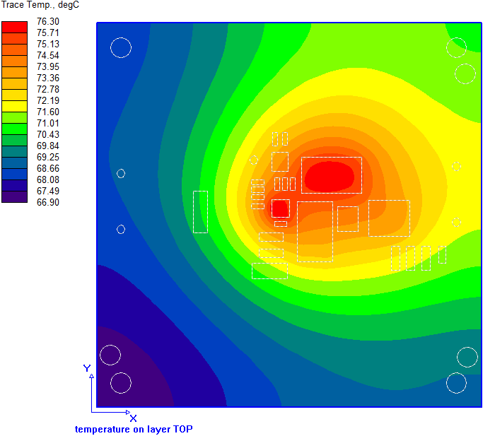
Thermal Analysis (Con’t)
Air temperature 45⁰C, power dissipation of BD95841MUV is 1.7216 W (at VIN=7.5V), include power dissipation of DNP diode D3 RB085B-30TL
U1: BD95841MUV
Max. power dissipation: 1.7216 W @VIN=7.5V
Component temperature = 93.3 ⁰C
L1: SPM6530T-3R3M
Max. power dissipation: 0.4752 W
Component temperature = 74.2 ⁰C
D3
D3:RB085B-30TL
Max. power dissipation: 1.92 W
Component temperature = 77.1 ⁰C
U1
L1
The highest temperature on board is about 76.3 ⁰C
The highest temperature on component is on BD95841MUV ( about 93.3 ⁰C)

Slide 21
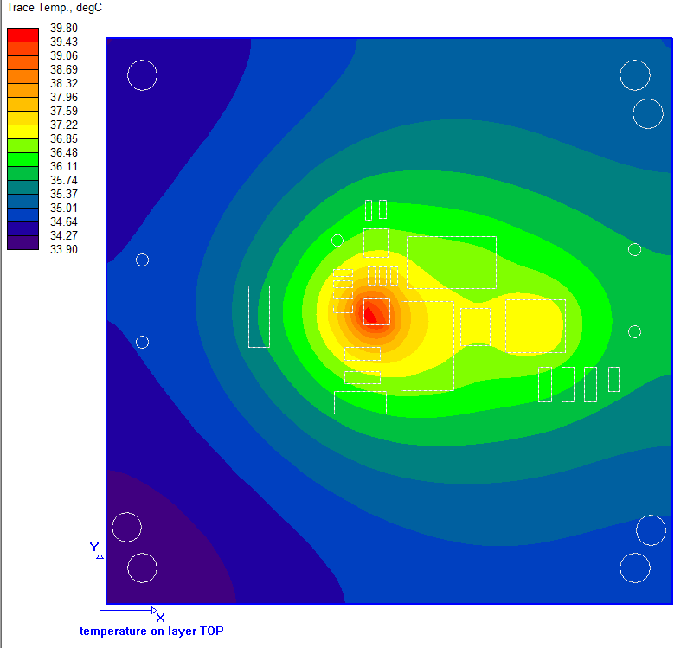
Thermal Analysis (Con’t)
Air temperature 25⁰C, power dissipation of BD95841MUV is 1.616 W (at VIN=12V), exclude power dissipation of DNP diode D3 RB085B-30TL
U1: BD95841MUV
Max. power dissipation: 1.616 W @VIN=12V
Component temperature = 55.6 ⁰C
L1: SPM6530T-3R3M
Max. power dissipation: 0.4752 W
Component temperature = 37.6 ⁰C
D3
D3:RB085B-30TL
Component temperature = 36.7 ⁰C
U1
L1
The highest temperature on board is about 39.8⁰C
The highest temperature on component is on BD95841MUV ( about 55.6 ⁰C)

Slide 22
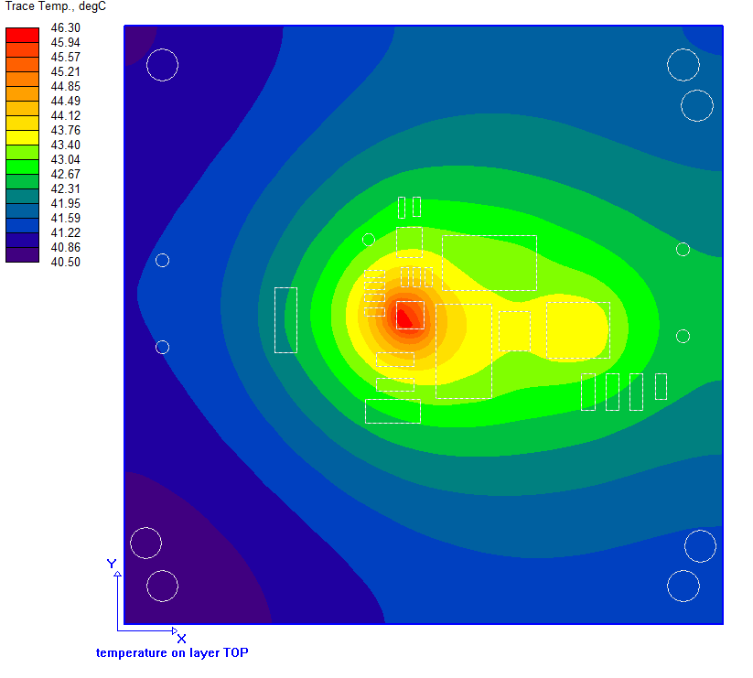
Thermal Analysis (Con’t)
Air temperature 35⁰C, power dissipation of BD95841MUV is 1.616 W (at VIN=12V), exclude power dissipation of DNP diode D3 RB085B-30TL
U1: BD95841MUV
Max. power dissipation: 1.616 W @VIN=12V
Component temperature = 62.1 ⁰C
L1: SPM6530T-3R3M
Max. power dissipation: 0.4752 W
Component temperature = 44.2 ⁰C
D3
D3:RB085B-30TL
Component temperature = 43.2 ⁰C
U1
L1
The highest temperature on board is about 46.3 ⁰C
The highest temperature on component is on BD95841MUV ( about 62.1 ⁰C)

Slide 23
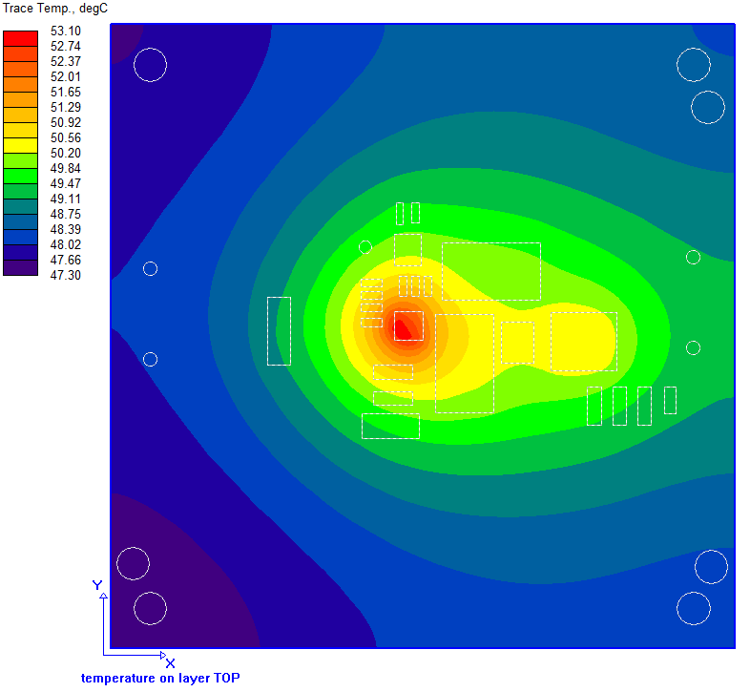
Thermal Analysis (Con’t)
Air temperature 45⁰C, power dissipation of BD95841MUV is 1.616 W (at VIN=12V), exclude power dissipation of DNP diode D3 RB085B-30TL
U1: BD95841MUV
Max. power dissipation: 1.616 W @VIN=12V
Component temperature = 68.9 ⁰C
L1: SPM6530T-3R3M
Max. power dissipation: 0.4752 W
Component temperature = 51 ⁰C
D3
D3:RB085B-30TL
Component temperature = 50.1 ⁰C
U1
L1
The highest temperature on board is about 53.1 ⁰C
The highest temperature on component is on BD95841MUV ( about 68.9 ⁰C)

Slide 24
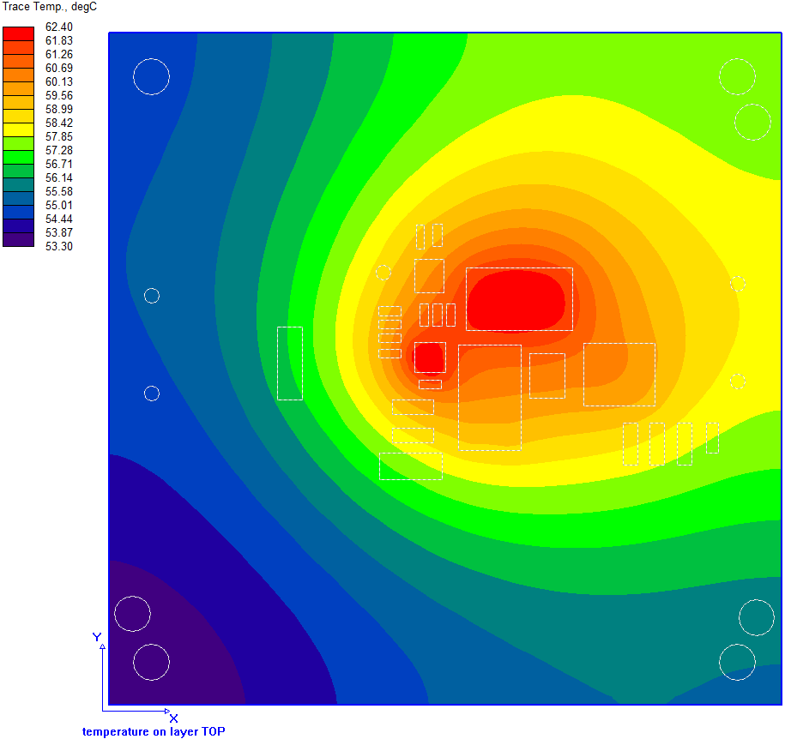
Thermal Analysis (Con’t)
Air temperature 25⁰C, power dissipation of BD95841MUV is 1.616 W (at VIN=12V), include power dissipation of DNP diode D3 RB085B-30TL
U1: BD95841MUV
Max. power dissipation: 1.616 W @VIN=12V
Component temperature = 78.3 ⁰C
L1: SPM6530T-3R3M
Max. power dissipation: 0.4752 W
Component temperature = 60.6 ⁰C
D3
D3:RB085B-30TL
Max. power dissipation: 1.92 W
Component temperature = 63.4 ⁰C
U1
L1
The highest temperature on board is about 62.4 ⁰C
The highest temperature on component is on BD95841MUV ( about 78.3 ⁰C)

Slide 25
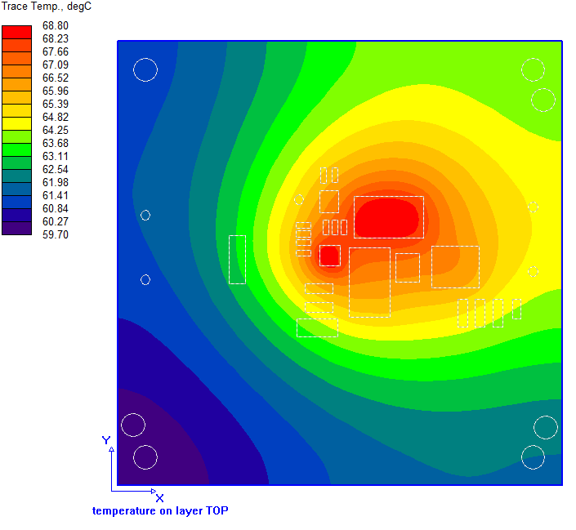
Thermal Analysis (Con’t)
Air temperature 35⁰C, power dissipation of BD95841MUV is 1.616 W (at VIN=12V), include power dissipation of DNP diode D3 RB085B-30TL
U1: BD95841MUV
Max. power dissipation: 1.616 W @VIN=12V
Component temperature = 84.7 ⁰C
L1: SPM6530T-3R3M
Max. power dissipation: 0.4752 W
Component temperature = 67 ⁰C
D3
D3:RB085B-30TL
Max. power dissipation: 1.92 W
Component temperature = 69.8 ⁰C
U1
L1
The highest temperature on board is about 68.8 ⁰C
The highest temperature on component is on BD95841MUV ( about 84.7 ⁰C)

Slide 26
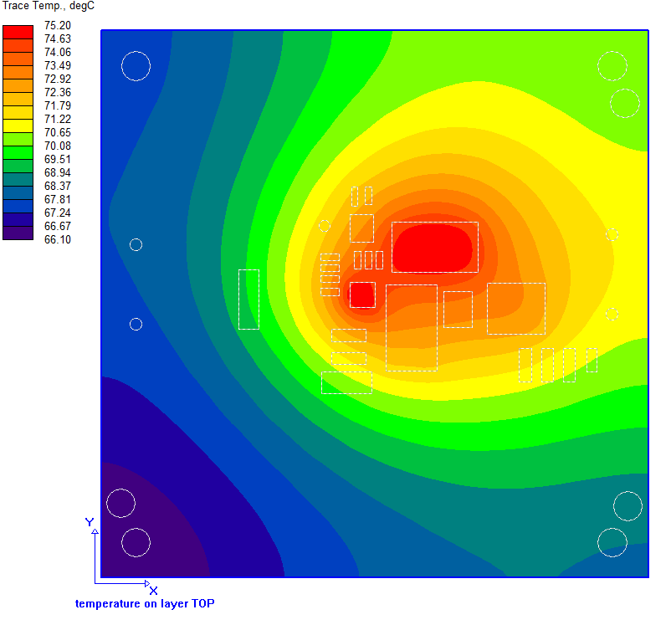
Thermal Analysis (Con’t)
Air temperature 45⁰C, power dissipation of BD95841MUV is 1.616 W (at VIN=12V), include power dissipation of DNP diode D3 RB085B-30TL
U1: BD95841MUV
Max. power dissipation: 1.616 W @VIN=12V
Component temperature = 91.1 ⁰C
L1: SPM6530T-3R3M
Max. power dissipation: 0.4752 W
Component temperature = 73.4 ⁰C
D3
D3:RB085B-30TL
Max. power dissipation: 1.92 W
Component temperature = 76.2 ⁰C
U1
L1
The highest temperature on board is about 75.2 ⁰C
The highest temperature on component is on BD95841MUV ( about 91.1 ⁰C)

Slide 27
Summary
The PI simulation shows that the max. amount voltage drop of VIN power is 2.7mV, the max. current density of VIN power is 20.7mA/mil²; the max. amount voltage drop of SW power is 0.4mV, the max. current density of SW power is 25.6mA/mil²; the max. amount voltage drop of VOUT power is 1.4mV, the max. current density of VOUT power is 36.8mA/mil²
The highest temperature of BD95841MUV board can be reached temperature as table below:
 | VIN=4.5V |  | VIN=12V
 | D1, D3: not install | D1, D3: install | D1, D3: not install | D1, D3: install
Air temperature: 25⁰C | 57.9 ⁰C | 80.6 ⁰C | 55.6 ⁰C | 78.3 ⁰C
Air temperature: 35⁰C | 64.5 ⁰C | 86.9 ⁰C | 62.1 ⁰C | 84.7 ⁰C
Air temperature: 45⁰C | 71.1 ⁰C | 93.3 ⁰C | 68.9 ⁰C | 91.1 ⁰C

